Slide 1
Assistive Technologies Teacher Survey
Chad Hamilton

Slide 2
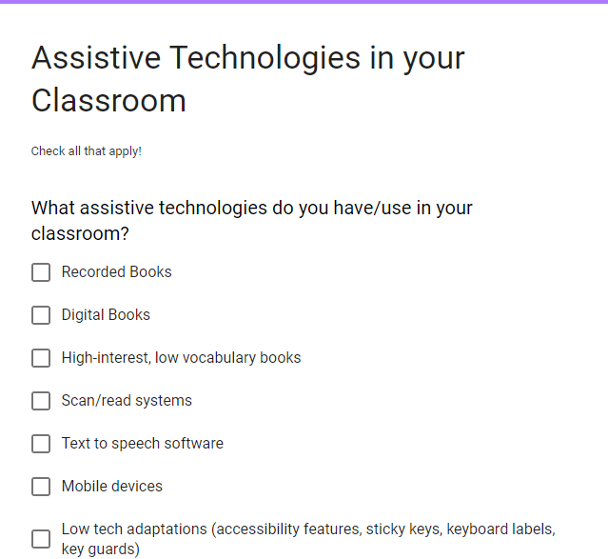
Google Form
A list of assistive tools was sent (email) to five Sped teachers in a google form. There was 100% participation. They had to select all that applies to them in terms of which assistive technology tools they have available/use in their classroom.
Google form is a web based app developed by Google. It creates forms/surveys for data collection. It is user friendly.
All answer choices on the google form are from Chapter 4 Lever-Duffy and McDonald, Teaching and Learning with Technology, 5th Edition

Slide 3
Assistive Technology Tools Listed on Google Form (1st Survey What teachers currently use)
Recorded Books
Digital Books
Hight-interest, low vocabulary books
Scan/read systems
Text to speech software
Mobile devices
Low tech adaptations (accessibility features, sticky keys, keyboard labels, key guards)
Touch screen devices
Expanded keyboards
Screen Magnification
Screen readers
Braille devices

Slide 4
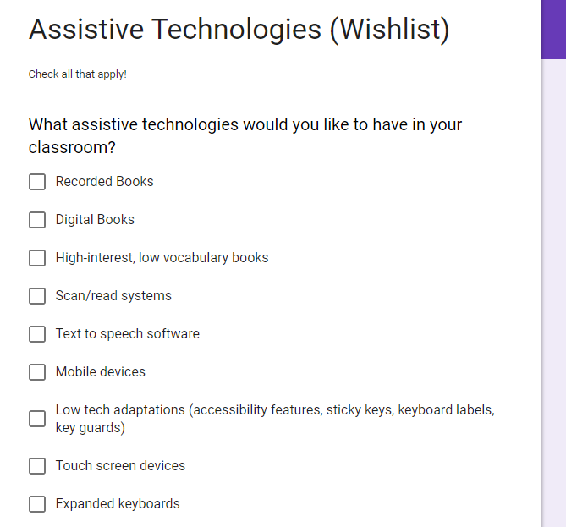
Second Survey
“What assistive technologies would you like to have in your classroom? “
Created a second google form and sent to the same five SPED teachers. This google asked teachers to choose which assistive technologies would they like to have in their classroom.
All answer choices on the google form are from Chapter 4 Lever-Duffy and McDonald, Teaching and Learning with Technology, 5th Edition

Slide 5
Assistive Technology Tools Listed on Google Form (2nd Survey What teachers wish they had)
Recorded Books
Digital Books
Hight-interest, low vocabulary books
Scan/read systems
Text to speech software
Mobile devices
Low tech adaptations (accessibility features, sticky keys, keyboard labels, key guards)
Touch screen devices
Expanded keyboards
Screen Magnification
Screen readers
Braille devices

Slide 6
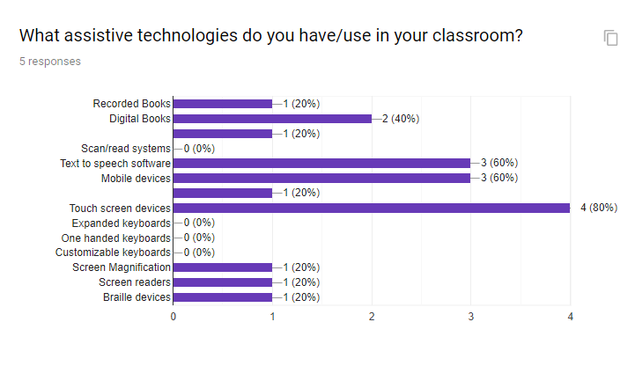
Results
“What assistive technologies do you HAVE/USE in your classroom? “
This is the results for what teachers currently have in their classroom.
Top 3 Assistive Technology tools in the classroom are:
  Touch Screen Devices
  Mobile Devices
  Text to Speech software

Slide 7
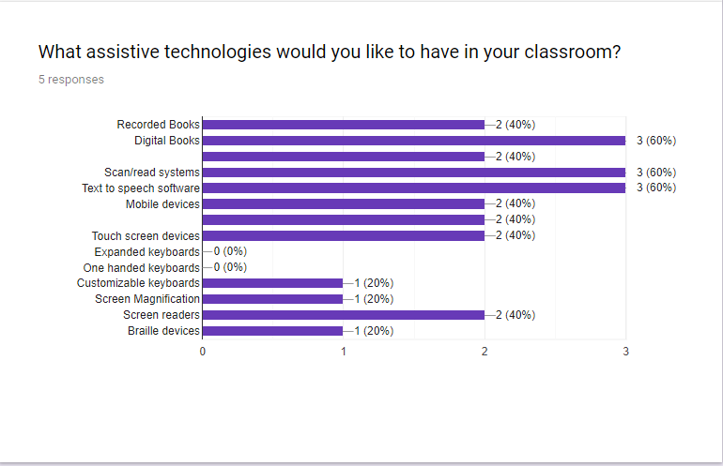
Results
“What assistive technologies would you LIKE TO HAVE in your classroom? “
This is the results for what teachers would like to have in their classroom.
Top 3 Assistive Technology tools wanted in the classroom are:
  Digital Book
  Scan/read systems
  Text to speech software

Slide 8
Results
“What assistive technologies do you have/use in your classroom? “
Text to speech software and Mobile devices
  Since technology is ubiquitous the availability of mobile devices is high. A high percentage of technology devise used are touch screen, allowing for easy access.
Text to speech software
  Students who have trouble reading are able to hear the content (math, social studies, science, etc) and answer questions without being hindered by their reading ability. This software should be readily available to every student who needs it and has computer access. The only issue is students would not use this software for reading because it would contradict what the reading teacher would be teaching.

Slide 9
Results
“What assistive technologies would you like to have in your classroom? “
Digital Books
  Ease of access
  Learning can happen anywhere
Scan/read systems
  Would allow a reduction in workload for teachers
Text to speech software
  Should be a requirement (computers/mobile devices are used in the school house, it would be easy to give access to text to speech software for each student)
  Allows students not to be hindered by their reading ability

